Slide 1


REGRESSION PROJECT FOR PREDICTING THE EXPENSES
Supervisor: Dr. Sharmishtha Mitra
Team Members: Vijay Kumar
Harshit Garg Sahil Yadav
Ravindra Pawan Yadav

Slide 2
INTRODUCTION
TARGET :- To predict the expenses using some factors like age, sex, region etc.
Use Multiple Regression Model
Handle problems like multicollinearity, heteroscedasticity and using variable selection method
Check the significance of predictors and predict the expenses

Slide 3
ABOUT THE DATA SET
RESPONSE VARIABLE(Y)-Expenses of the person(in Rs.) (To be predicted)
PREDICTORS(X1,X2,…,X8)-
X1: Age of the person
X2: Sex of the person
X3: BMI of the person
X4: Number of children of the person
X5: (Smoker) Whether the person is a smoker or not
X6: (SE) Whether the person belongs to southeast region or not
X7: (NW) Whether the person belongs to northwest region or not
X8: (NE) Whether the person belongs to northeast region or not
There are in total 1339 observations in the data set.

Slide 4
MODEL AND ASSUMPTIONS
Model:
The multiple regression model used for this project is: Y_{i}=β₀ + ∑β_{j} X_{j} + ε_{i} ;j=1(1)8,i=1(1)1338
Assumptions:
ε_{i}’s are normally distributed.
E(ε_{i})=0 and Var(ε_{i})=σ² for all i=1(1)1338
ε_{i}’s are independently distributed.
Cov(x_{i},x_{k})=0 for all i ≠ k.

Slide 5
SUMMARY
Coefficients | Estimates | Std. Error | t-value | Pr(>|t|)
Intercept | -12900.87 | 1020.90 | -12.637 | <2e-16
x1 | 256.84 | 11.90 | 21.586 | <2e-16
x2 | -131.35 | 332.94 | -0.395 | 0.693255
x3 | 339.29 | 28.60 | 11.864 | <2e-16
x4 | 475.69 | 137.80 | 3.452 | 0.000574
x5 | 23847.48 | 413.14 | 57.723 | <2e-16
x6 | -76.29 | 470.64 | -0.162 | 0.871253
x7 | 606.52 | 477.18 | 1.271 | 0.203940
x8 | 959.31 | 477.91 | 2.007 | 0.044921
Residual Standard Error : 6062 on 1329 degrees of freedom
Multiple R-Squared : 0.7509
Adjusted R-Squared : 0.7494
F-Statistic : 500.9 on 8 and 1329 degrees of freedom
p-value : <2.2e-16

Slide 6
ANALYSIS OF VARIANCE TABLE
 | Df | Sum Sq | Mean Sq | F value | Pr(>F)
X1 | 1 | 1.7530e+10 | 1.7530e+10 | 477.0535 | <2.2e-16
X2 | 1 | 7.9167e+08 | 7.9167e+08 | 21.5438 | 3.8e-06
X3 | 1 | 5.2716e+09 | 5.2716e+09 | 143.4567 | <2.2e-16
X4 | 1 | 5.5148e+08 | 5.5148e+08 | 15.0076 | 0.0001123
X5 | 1 | 1.2286e+11 | 1.2286e+11 | 3343.4020 | <2.2e-16
X6 | 1 | 8.2015e+07 | 8.2015e+07 | 2.2319 | 0.1354247
X7 | 1 | 3.3750e+06 | 3.3750e+06 | 0.0918 | 0.7618929
X8 | 1 | 1.4806e+08 | 1.4806e+08 | 4.0292 | 0.0449214
Residuals | 1329 | 4.8837e+10 | 3.6747e+10

Slide 7
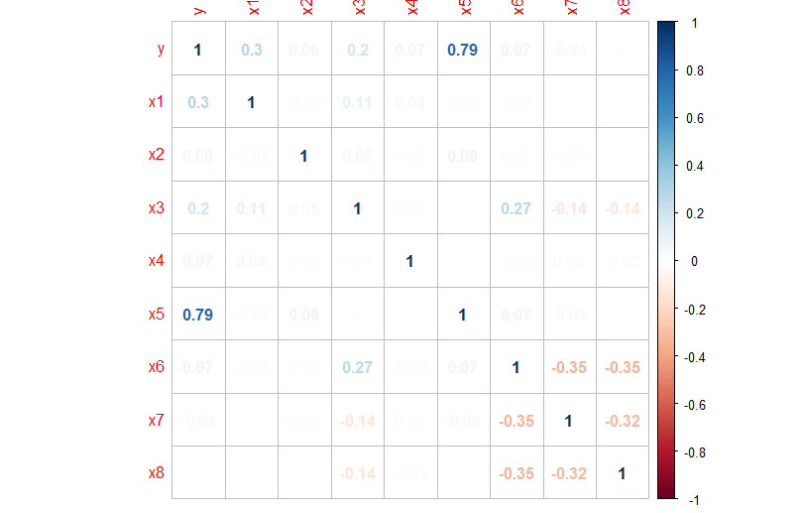
MULTICOLLINEARITY
It is a correlation matrix which gives correlation between response and regressors.
Here entries in blue colour shows positive multicollinearity and entries in red colour shows negative collinearity.

Slide 8
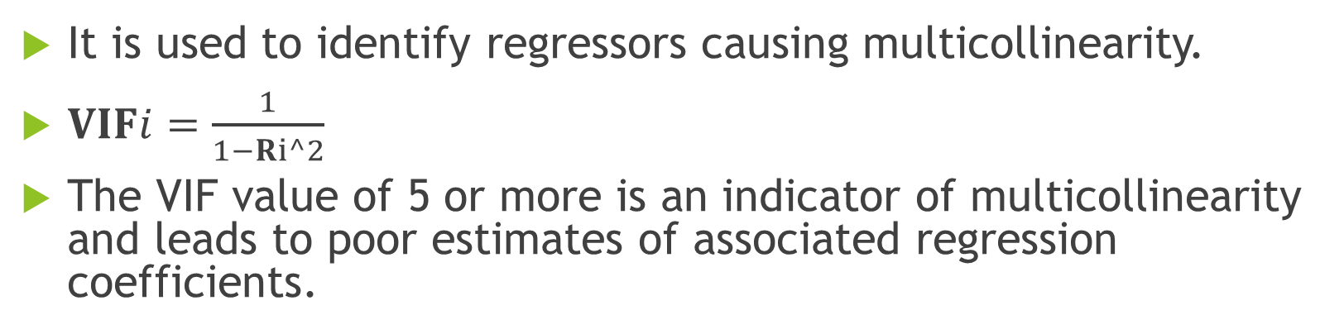
VARIANCE INFLATION FACTOR
It is used to identify regressors causing multicollinearity.
$VIFi=\frac{1}{1−Ri^2}$
The VIF value of 5 or more is an indicator of multicollinearity and leads to poor estimates of associated regression coefficients.
x1 | x2 | x3 | x4 | x5 | x6 | x7 | x8
1.016843 | 1.008900 | 1.106682 | 1.004008 | 1.012067 | 1.597204 | 1.524717 | 1.526170
From the table, we have that the VIF value of all the variables is less than 5. Hence, regressors are free from multicollinearity.

Slide 9
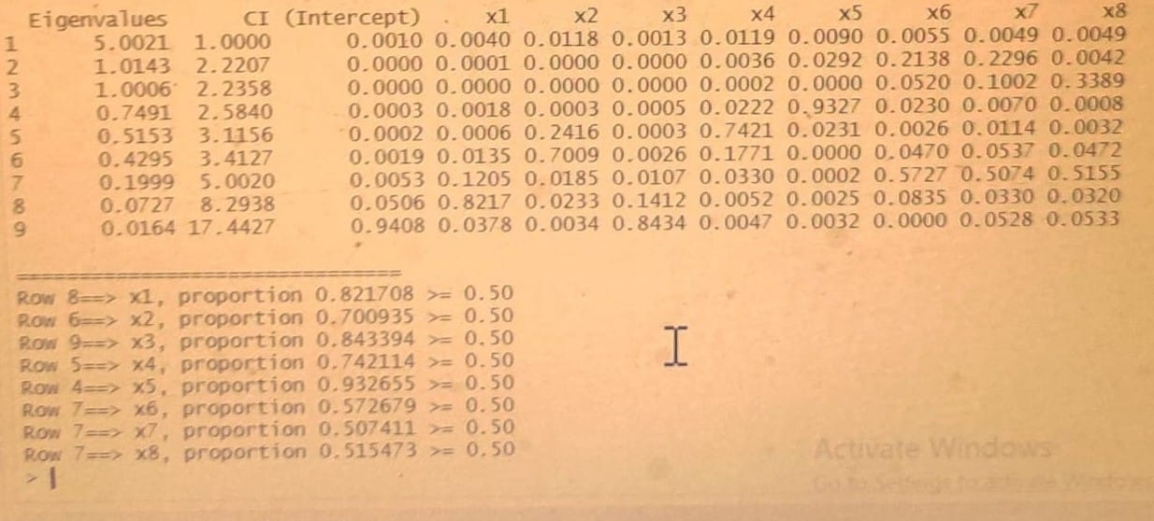
VARIANCE DECOMPOSITION METHOD
It is a method to identify subsets of regressors involved in multicollinearity.
Here, corresponding to largest condition indices, if we find a high proportion of variance associated with two or more regression coefficients, we identify those regressors as multi-collinear subsets.
Since maximum condition index is 17.4427 which is > 15 but there are no such corresponding subset of regressors which are > 0.5. Hence our model is free from multicollinearity.

Slide 10
CHECKING SKEWNESS IN DATA
X1 | X2 | X3 | X4 | X5 | X6 | X7 | X8
0.05561008 | -0.0209279 | 0.2842738 | 0.9373281 | 1.463124 | 1.024471 | 1.199063 | 1.203809
Values of skewness fall between -3 and +3 of all the regressors.
This is an indication of acceptable skewness
Hence, there is no need to check outliers.

Slide 11
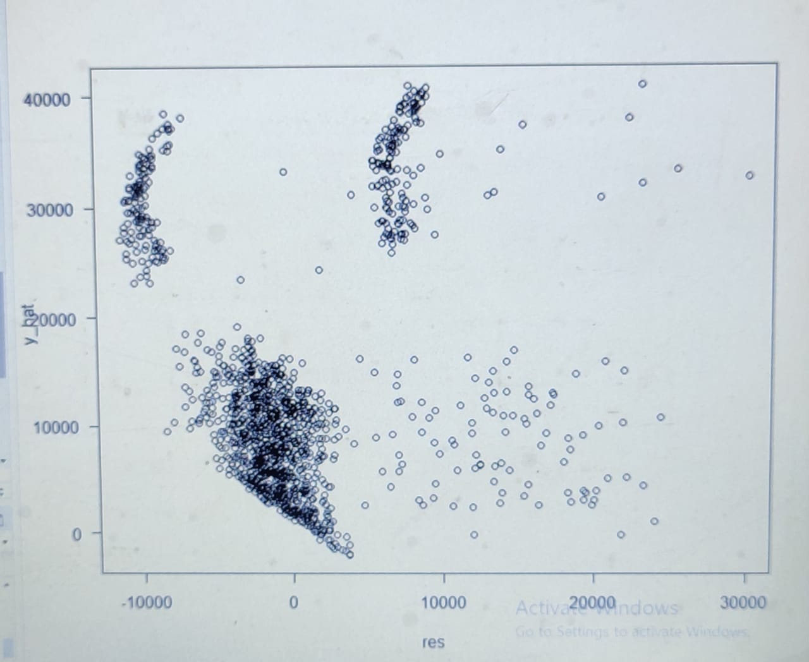
GRAPHS FOR CHECKING HETEROSCEDASTICITY
GRAPH BETWEEN RESIDUALS(res) AND FITTED RESPONSES(y_hat)
The covariance between residuals(res) and fitted response(y_hat) is 0.0000000000000000846319= 8.46319e-17 (almost zero)
Hence, our assumption on homoscedastic error holds true.

Slide 12
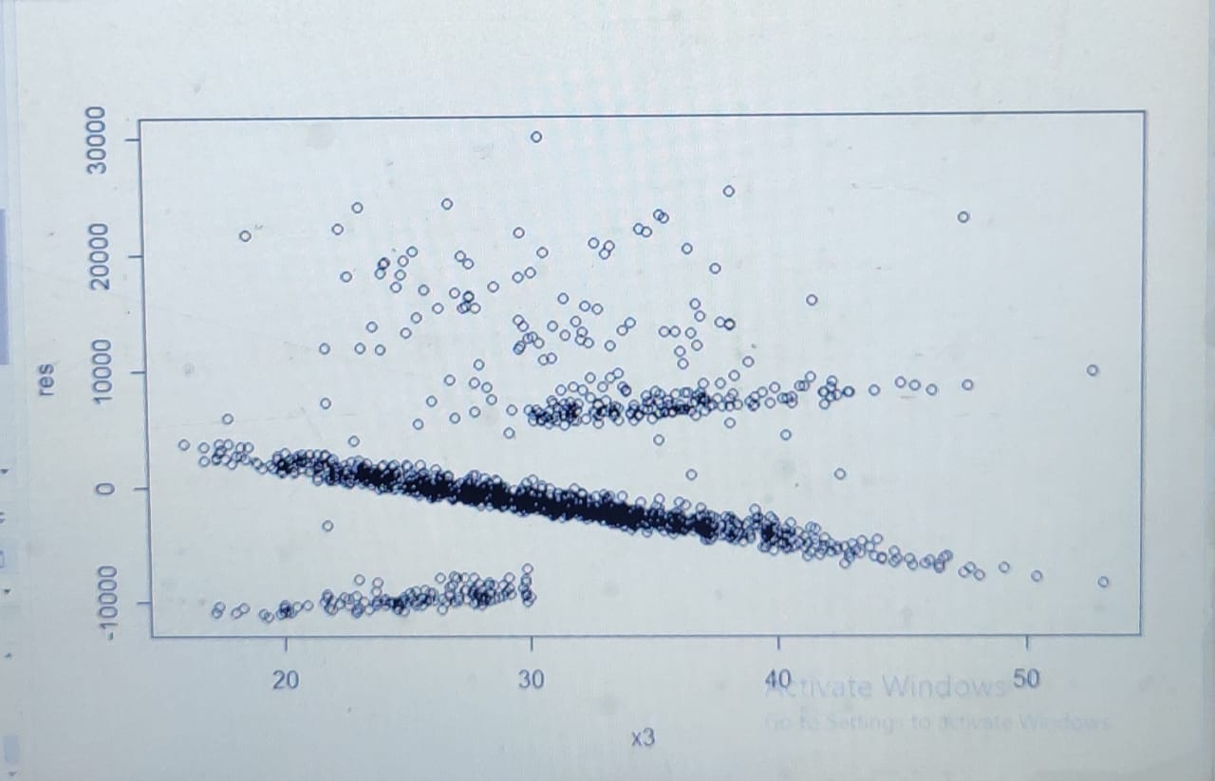
GRAPH BETWEEN REGRESSOR(X3) AND RESIDUAL(res)
The plot is close to a outward opening funnel.Hence,heteroscedasticity might be preent.
So, to ensure our usual error assumptions, we need to account for this and make changes to our model.
The way we can accommodate such a relationship is by dividing the model on both sides by the BMI regressor.

Slide 13
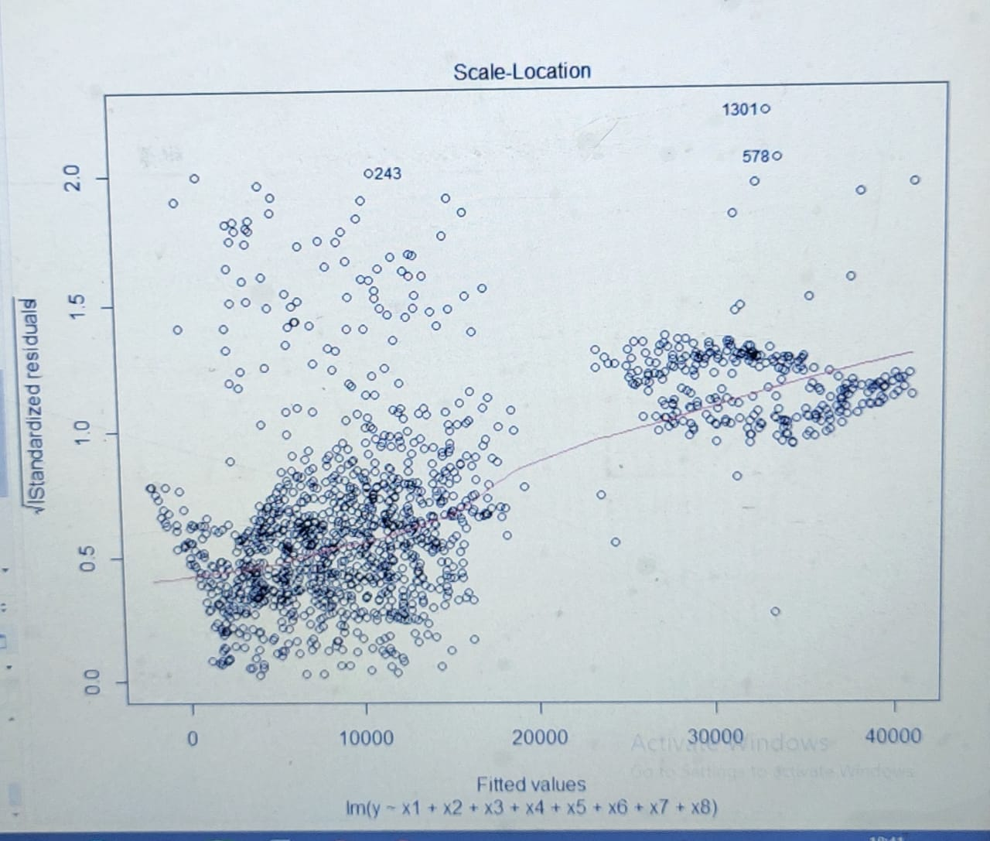
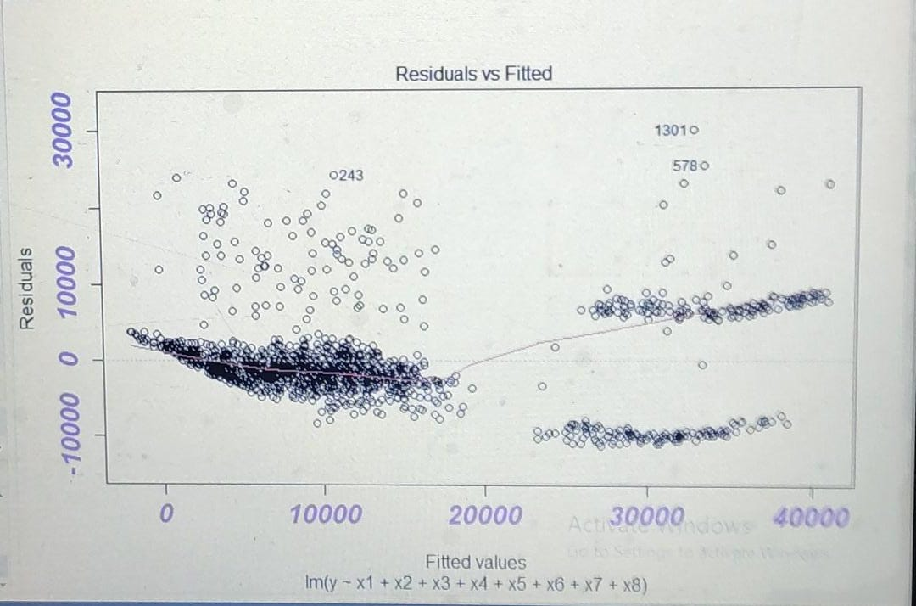
SCALING THE RESIDUALS
Here, we have applied the weights, weights=1/sqrt(x3) to check for heteroscedasticity.
Applying studentized Breusch-Pagan test , BP=121.59,df=8,p-value<2.2e-16

Slide 14
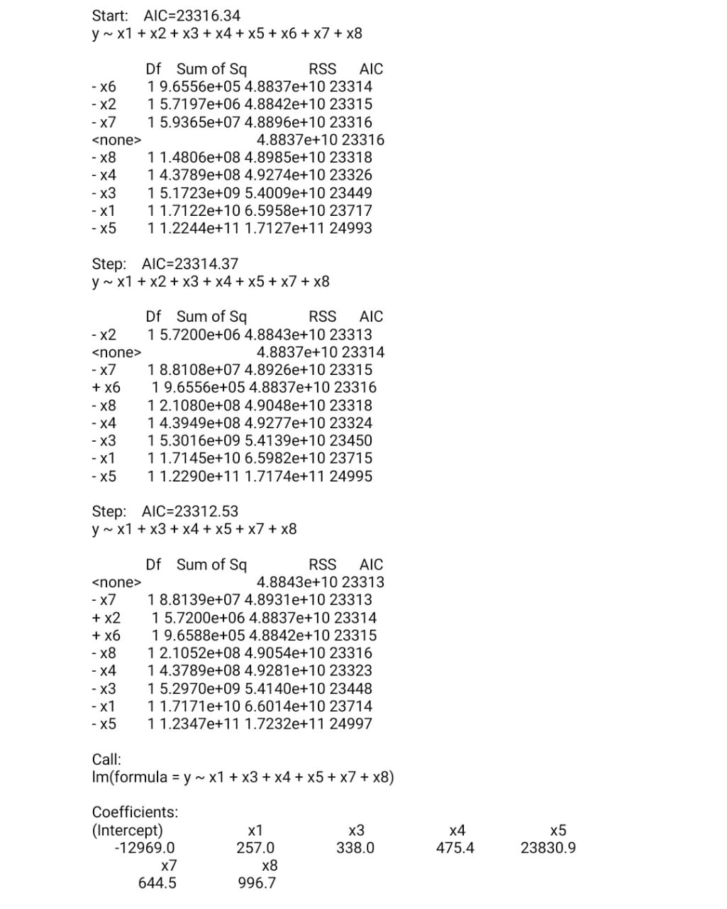
VARIABLE SELECTION METHOD
AKAIKE INFORMATION CRITERION
The Akaike Information Criterion(AIC) is a measure of the relative quality of statistical models for a given set of data. Given a collection of models for the data, AIC estimates the quality of each model, relative to each of the other models. Hence, AIC provides a means for model selection.
AIC=23316.34
By using the stepwise selection procedure, we conclude that the variables X2 and X6 should be removed from the model.
So the model after variable selection is
Y=-12969 + 257*X1 + 338*X3 + 475.4*X4+23830*X5 + 644.5*X7 + 996.7*X8

Slide 15
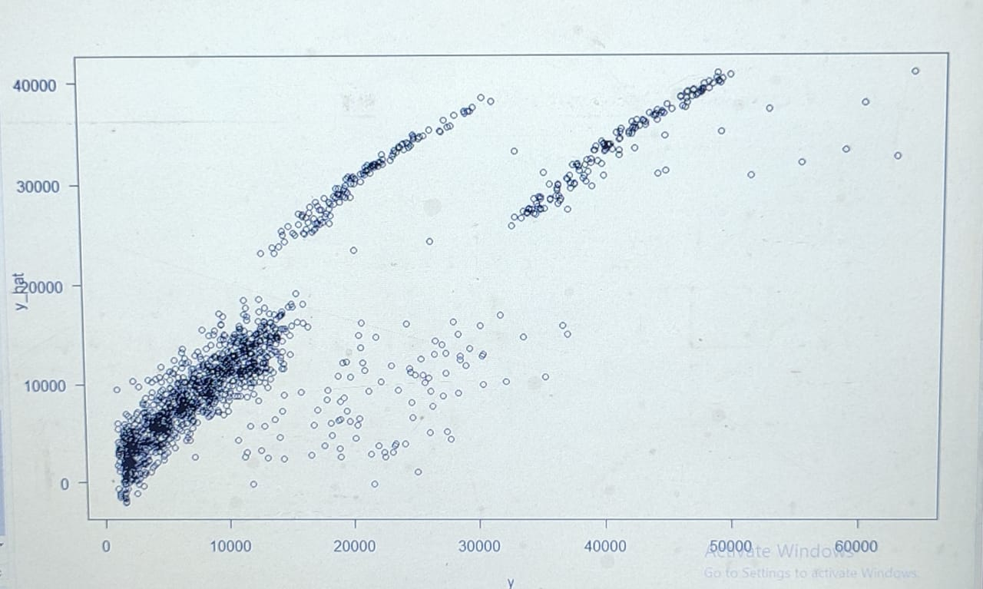
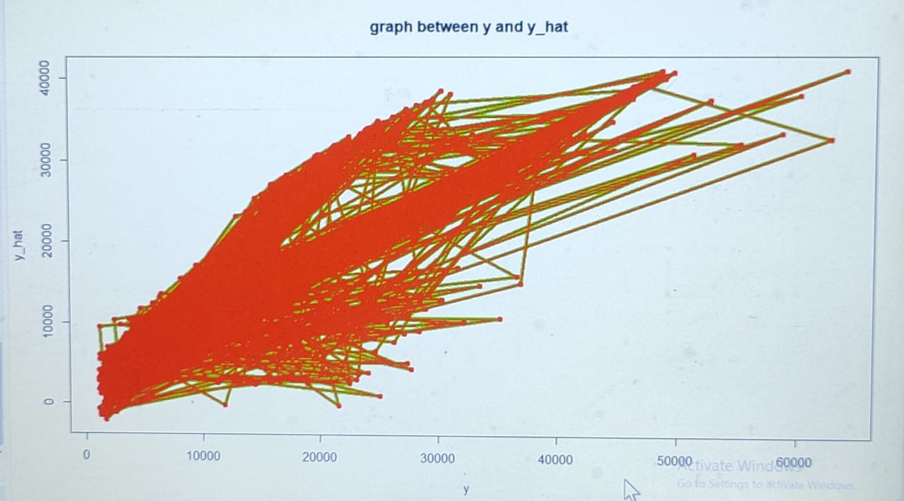
PREDICTION OF DATA
From the above graphs, we can conclude that there is quite strong relationship between observed values and fitted values. The correlation between observed values and fitted values is 0.8665613.

Slide 16
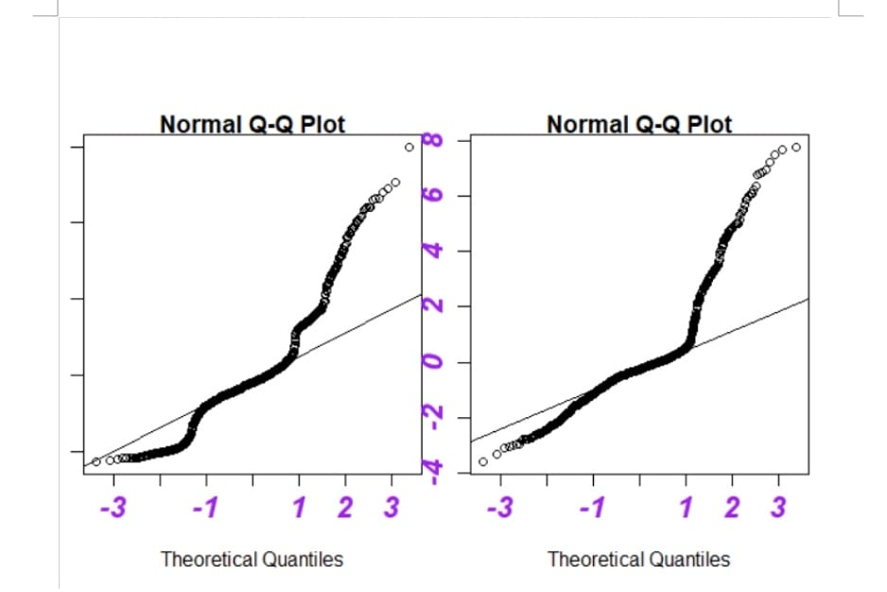
CHECKING NORMALITY
We have done the transformation y=(y^λ-1)/ λ. And the Normal Q-Q Plots before and after transformation are shown below.
Before transformation After transformation
From the graphs, we can clearly conclude that values are more in a straight line after transformation and hence our assumption on normality holds true.

Slide 17
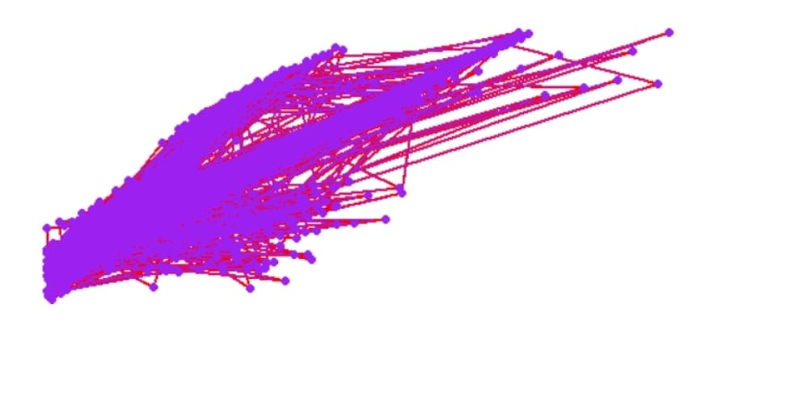
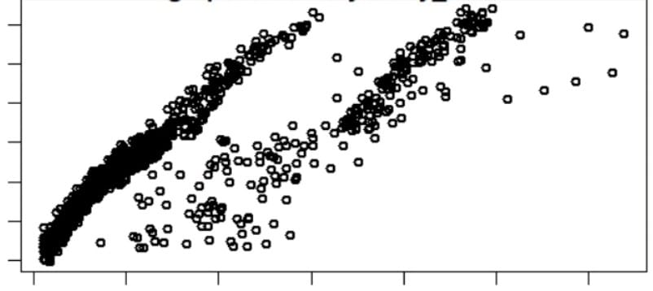
PREDICTION OF DATA(AFTER TRANSFORMATION)

Slide 18
CONCLUSION
From the graph between observed values and fitted values, we conclude that there is a very strong correlation between them. Hence, the fitted values are approximately equal to observed values of response variables(Expenses). So from our analysis we come to conclusion that the Expenses of an individual depend upon his age, BMI, number of children , whether he is a smoker or not, whether he belongs to northwest region or not and whether he belongs to northeast region or not. Hence, by optimizing these variables, we can optimize the expenses of that individual.

